Slide 1
Characteristics of Life
https://www.ck12.org/biology/characteristics-of-life/lesson/Characteristics-of-Life-Advanced-BIO-ADV/?referrer=concept_details

Slide 2
Learning Objectives
Identify the seven characteristics of living things.
Define cell
Describe an adaptation
Explain a complex chemistry
Describe the importance of homeostasis

Slide 3
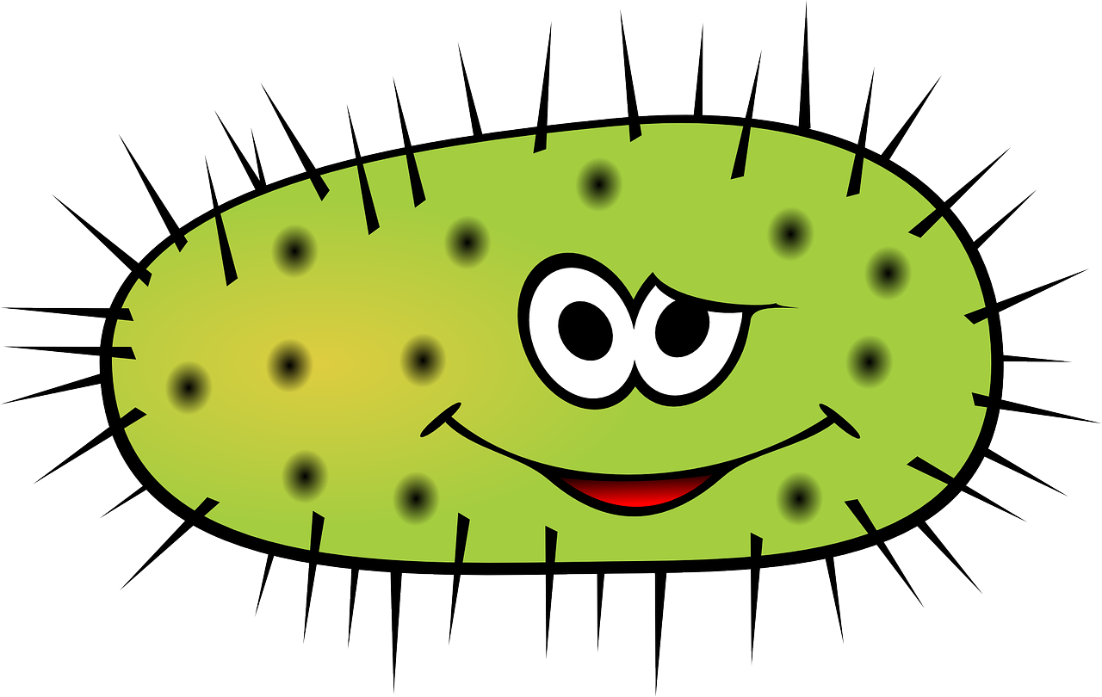

Characteristics of Life
Bacterium Vs. Whale
  What do they have in common?
    All living organisms, from the smallest bacterium to the largest whale, share certain characteristics of life.
    All living things are made of cells.
    All living things must reproduce to make the next generation.
    Without these characteristics, there is no life.

Slide 4
Biology
Biology examines the structure, function, growth, origin, evolution, and distribution of living things.
Biology classifies and describes organisms, their functions, how species come into existence, and the interactions they have with each other and with the natural environment.
Four unifying principles form the foundation of modern biology
  Cell theory
  Evolution
  Genetics
  Homeostasis

Slide 5
What is life?
Biologists define life by listing characteristics that living things share.
Something that has ALL of the characteristics of life is considered to be alive.
  An individual living creature is called an organism. There are many characteristics that living organisms share. All living organisms:
    Respond to their environment
    Grow and change
    Have complex chemistry
    Maintain homeostasis
    Are built of structures called cells
    Pass their traits onto their offspring

Slide 6
#1 Responding to the Environment
All living organisms respond to their environment.
Living things know what is going on around them, and respond to changes in the environment.
An adaptation refers to the process of becoming adjusted to an environment.
Adaptation may include
  Structural
  Physiological
  Behavioral traits that improve an organism’s likelihood of survival, and thus, reproduction.

Slide 7
#2 Growth and Change
All living organisms have the ability to grow and change.
A seed may look like a pebble, but under the right conditions it will sprout and form a seedling that will grow into a larger plant.
Even the smallest bacteria must grow (This bacteria will reproduce by dividing into two separate bacterium.

Slide 8
#3 Reproduction
All living organisms must have the ability to reproduce.
Living things make more organisms like themselves.
If a species cannot create the next generation, the species will go extinct.
Reproduction is the process of making the next generation and bay be a sexual or an asexual process.
  Sexual reproduction: involves two parents and the fusion of gametes, haploid sex cells from each parent (produces offspring that are genetically unique and increases genetic variation within a species).
  Asexual reproduction: involves only one parent. It occurs without a fusion of gametes (produces offspring that are all genetically identical to the parent).

Slide 9
#4 Have Complex Chemistry
All living organisms have a complex chemistry.
A flower has a complicated and beautiful structure.
  Transports water through its petals
  Produces pigment molecules
  Breaks down sugar for energy
  Undergoes a large number of other biochemical reactions that are needed for living organisms to stay alive.
The sum of all the chemical reactions in a cell is metabolism.

Slide 10
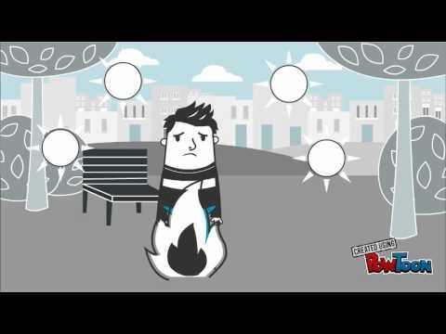
#5 Maintain Homeostasis
A human body has a temperature of 98.6 degrees Fahrenheit.
Homeostasis is a process of keeping internal environments within a certain range, (living organisms will be able to maintain a stable internal conditions) despite changes in their external environment.
  Example: If you step outside on a cold morning, the temperature might be below freezing. Nevertheless, you do not become an ice cube! You shiver and the movement in your arms and legs allows you to stay warm: THAT IS HOMEOSTASIS.

Slide 11
#6 Built of Cells
All living organisms are made of structures called cells.
Organisms that are very different such as ferns, fish, and elephants all look similar at the cellular level.
A cell is the basic unit of structure and function of all living organisms.
All living organisms are made of one or more cells: a simple bacterium will consist of just one cell, whereas you are made of trillions of cells!
Atoms -> molecules -> macromolecules -> organelles -> cells.
Cells -> tissue -> organs -> organ systems -> entire organism.

Slide 12
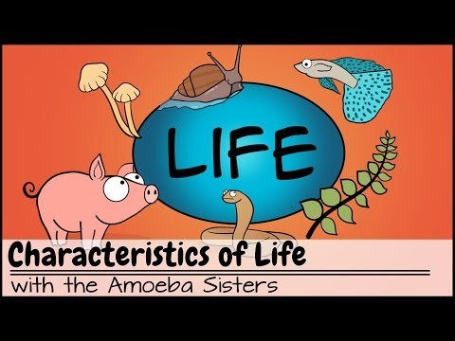
Video to Watch

Slide 13
Your assignment
Answer the 5 questions below on a separate sheet of paper, take a picture of it and upload to the assignment folder under “Characteristics of Life”.
What are the four unifying principles that form the foundation of modern biology?
Identify three of the seven characteristics of living things.
What is adaptiation?
Distinguish between metabolism and homeostasis.
What is a cell?

